Slide 1
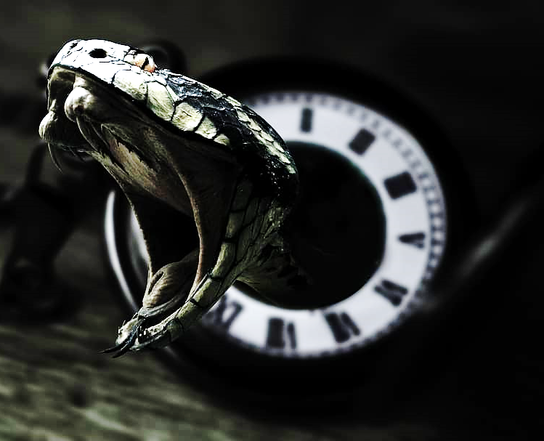


CONDACLOCK
hisssssss!!
Created by: Dylan D’Angelo
Condaclock is a snake themed alarm app that emits a bone-chilling hiss when you want to wake up.
Github: https://github.com/ksu-is/Condaclock

